Slide 1




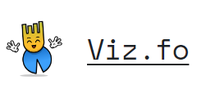


Big thank you to our great sponsors

Slide 2
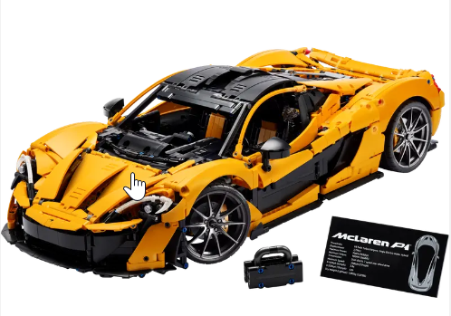

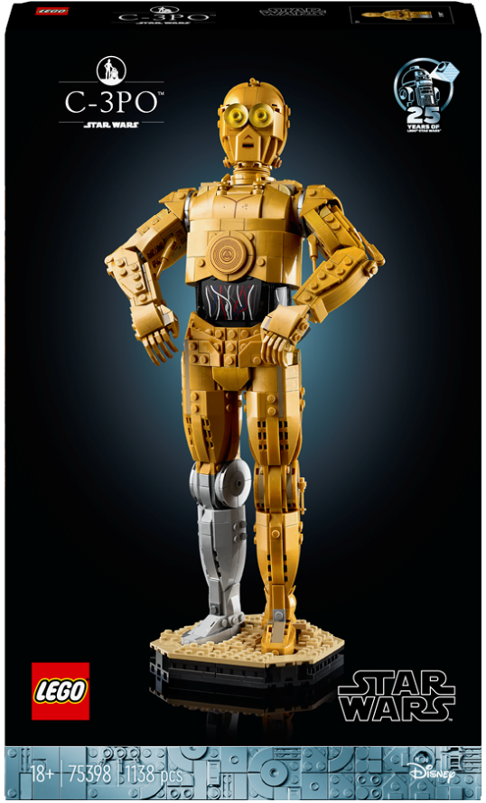
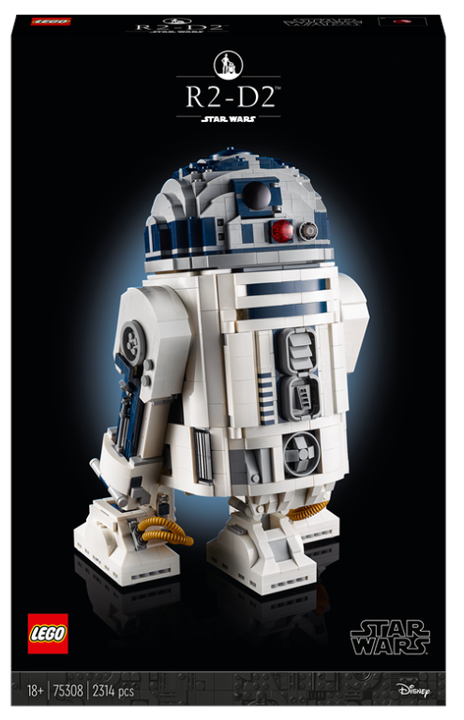

Raffle prizes from the sponsors

Slide 3

Tabular Editor Scripting Magic
Selected.Patronum.Output();

Slide 4
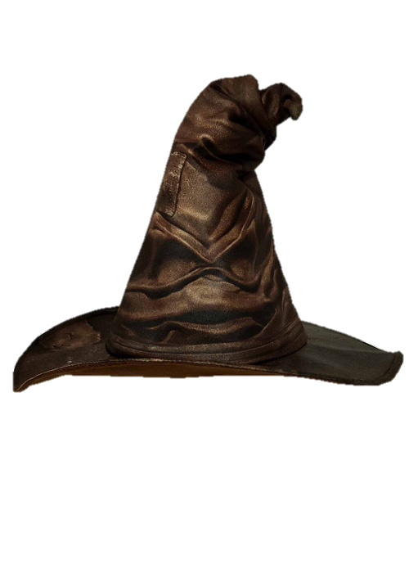
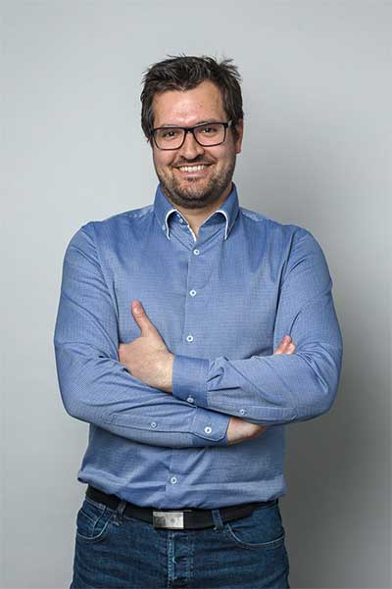
About me
Daniel Otykier
Inventor of Tabular Editor
CTO @ Tabular Editor ApS
Microsoft Data Platform MVP (5 years)
Power BI Contributor (“External Tools” ribbon)

Slide 5
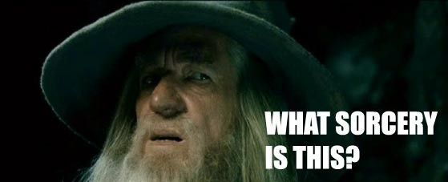
What is Tabular Editor scripting?
One size rarely fits all…
Pro software must be extensible
Tabular Editor uses C# for scripting
Use scripts to modify the model metadata
Use scripts to interact with the user
Save scripts as custom macros
integrates directly in Tabular Editors UI
Available in both TE2 and TE3!!!

Slide 6
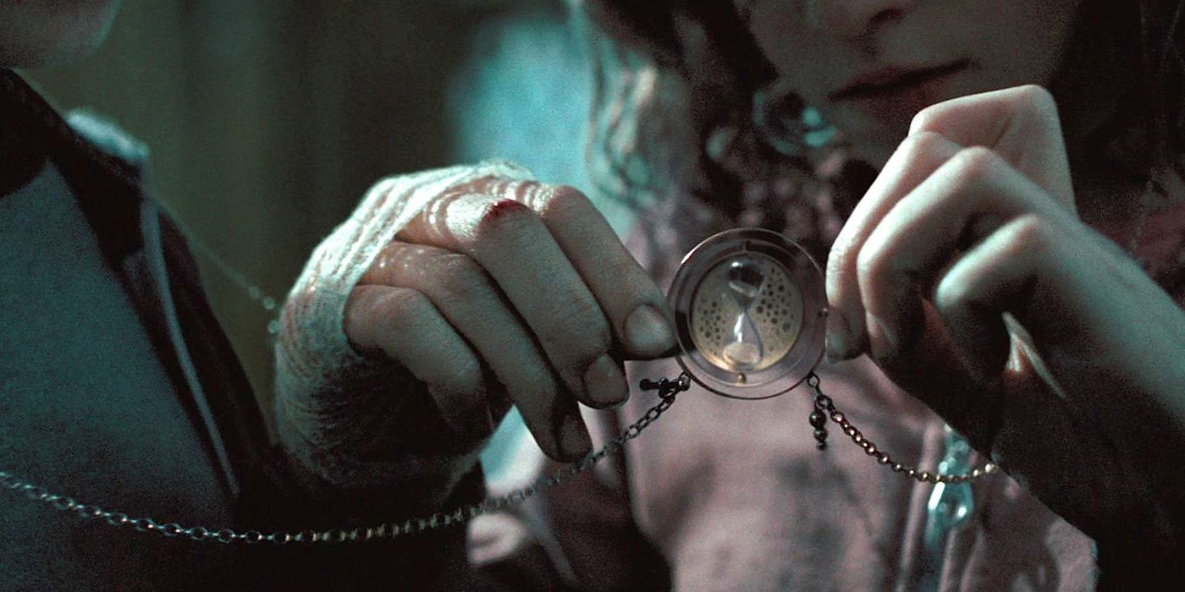
Time Intelligence on Steroids

Slide 7
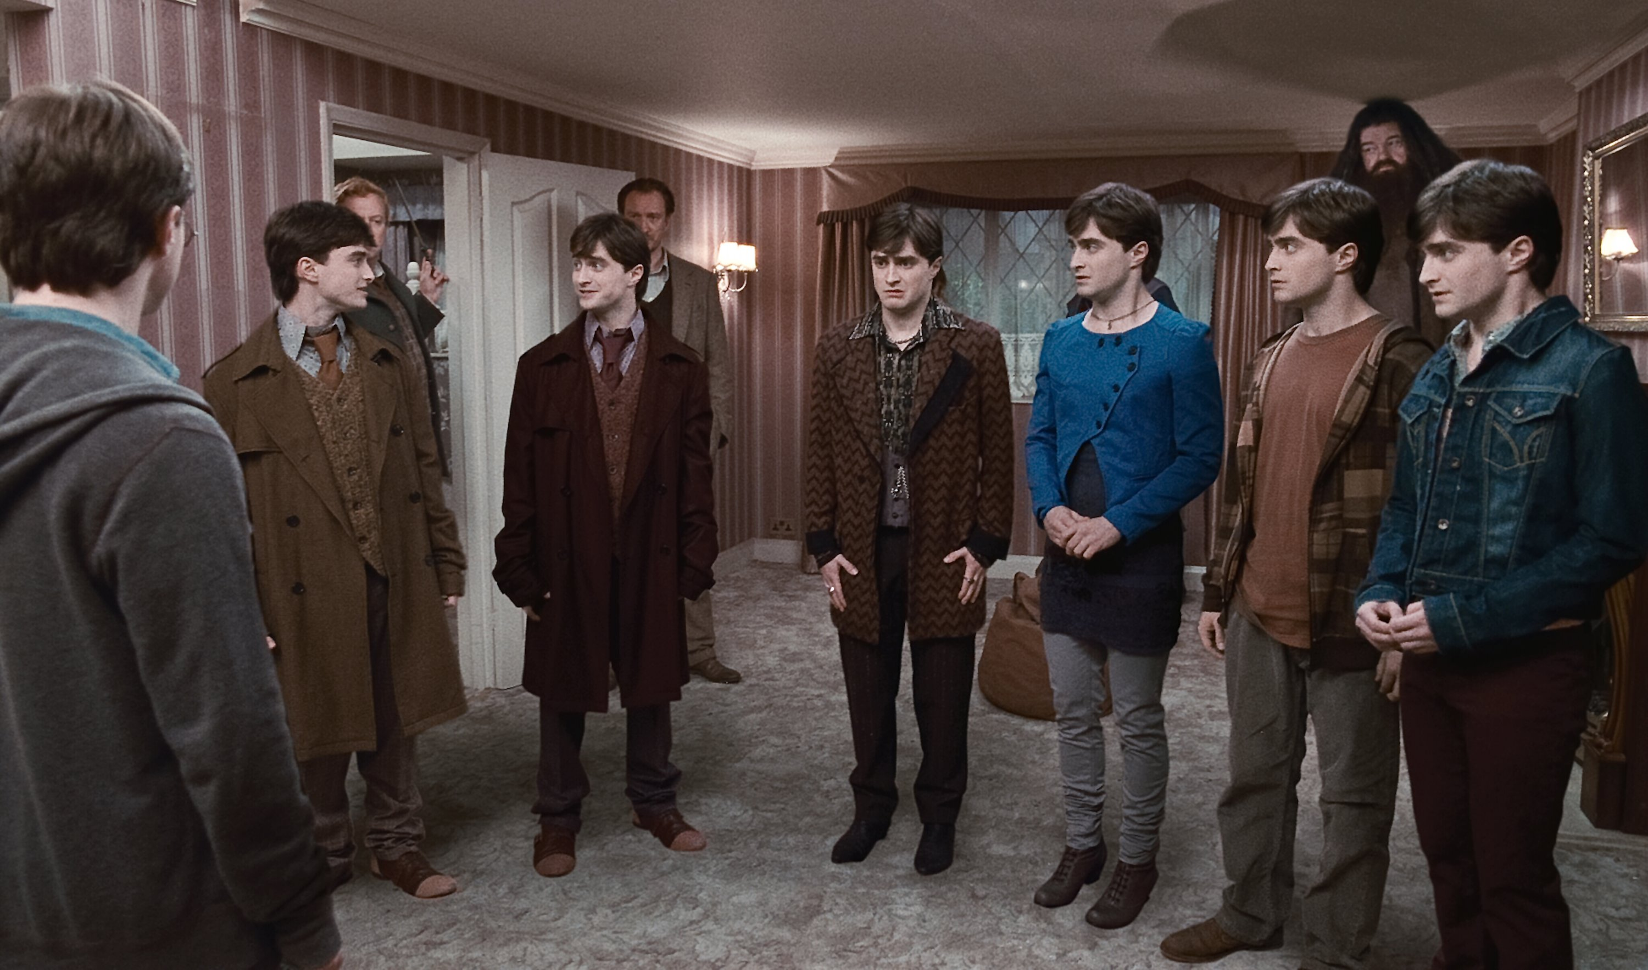
Master Model Pattern
Notes:
Load TMSL model in TE2 and explain the $ perspectives – show script and run it once
Close TE2 without saving
Show SSMS – no databases other than “AdventureWorks”
Run: deploy-submodels.cmd
Run: full-refresh-all.cmd
Show SSMS – now we have databases
Open TMSL in TE2 – modify date table, e.g.: add measure “Number of weekdays” – include in all perspectives: CALCULATE( COUNTROWS('Date'), 'Date'[Day Number Of Week] >= 2 && 'Date'[Day Number Of Week] <= 6 )
Save TMSL
Run: deploy-submodels.cmd again
Now, show that [Number of weekdays] is included in all models

Slide 8
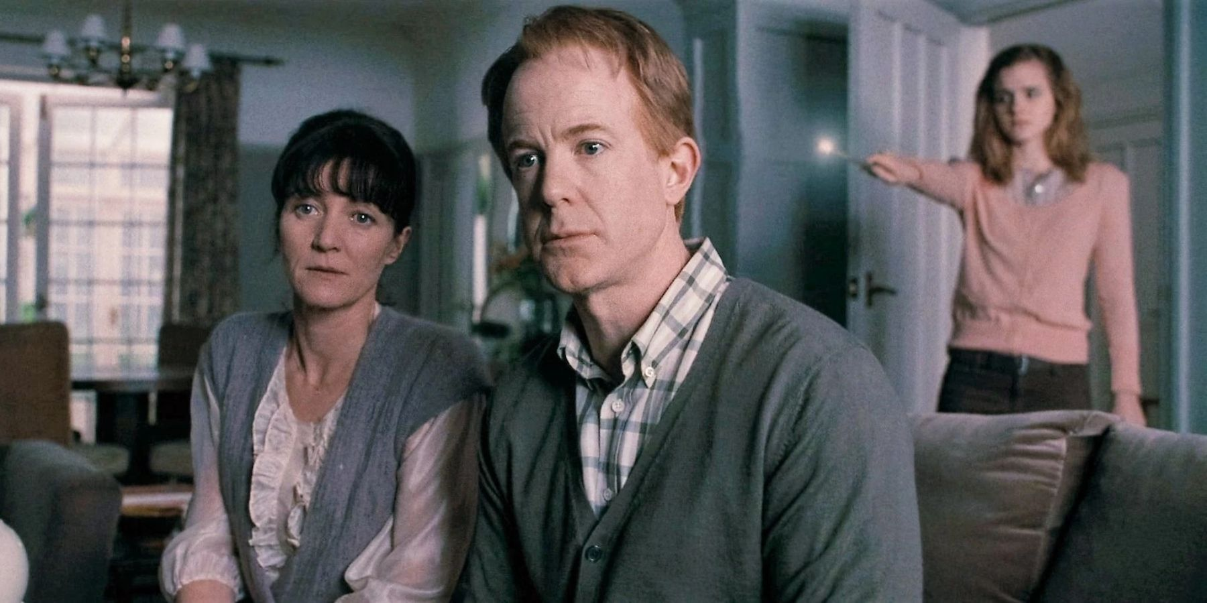
Model Refresher
Credit:
Michael Kovalsky
elegantbi.com

Slide 9
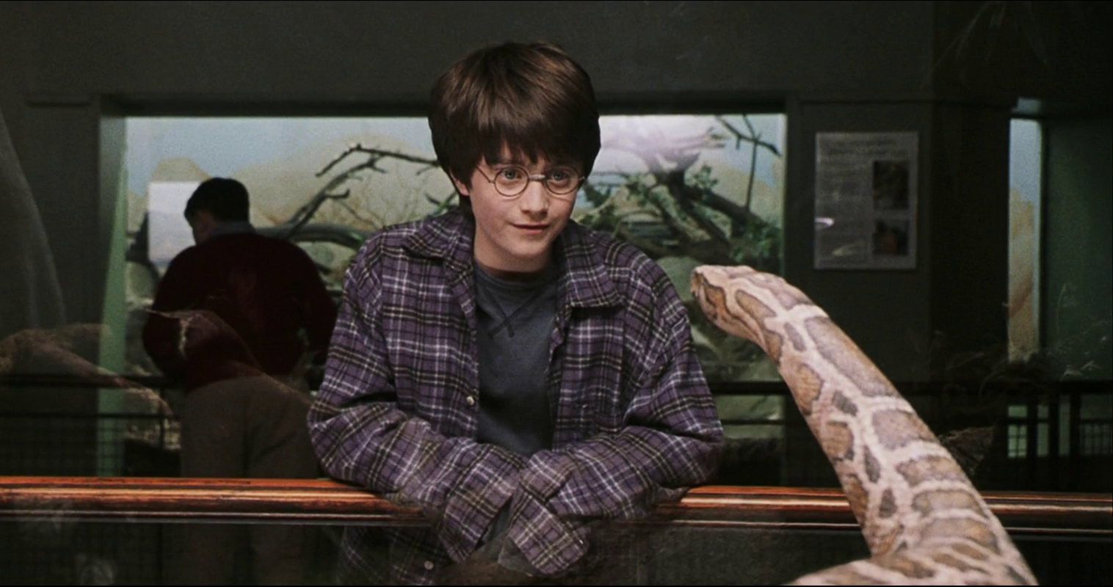
Invoking ChatGPT
Credit:
David Bojsen

Slide 10
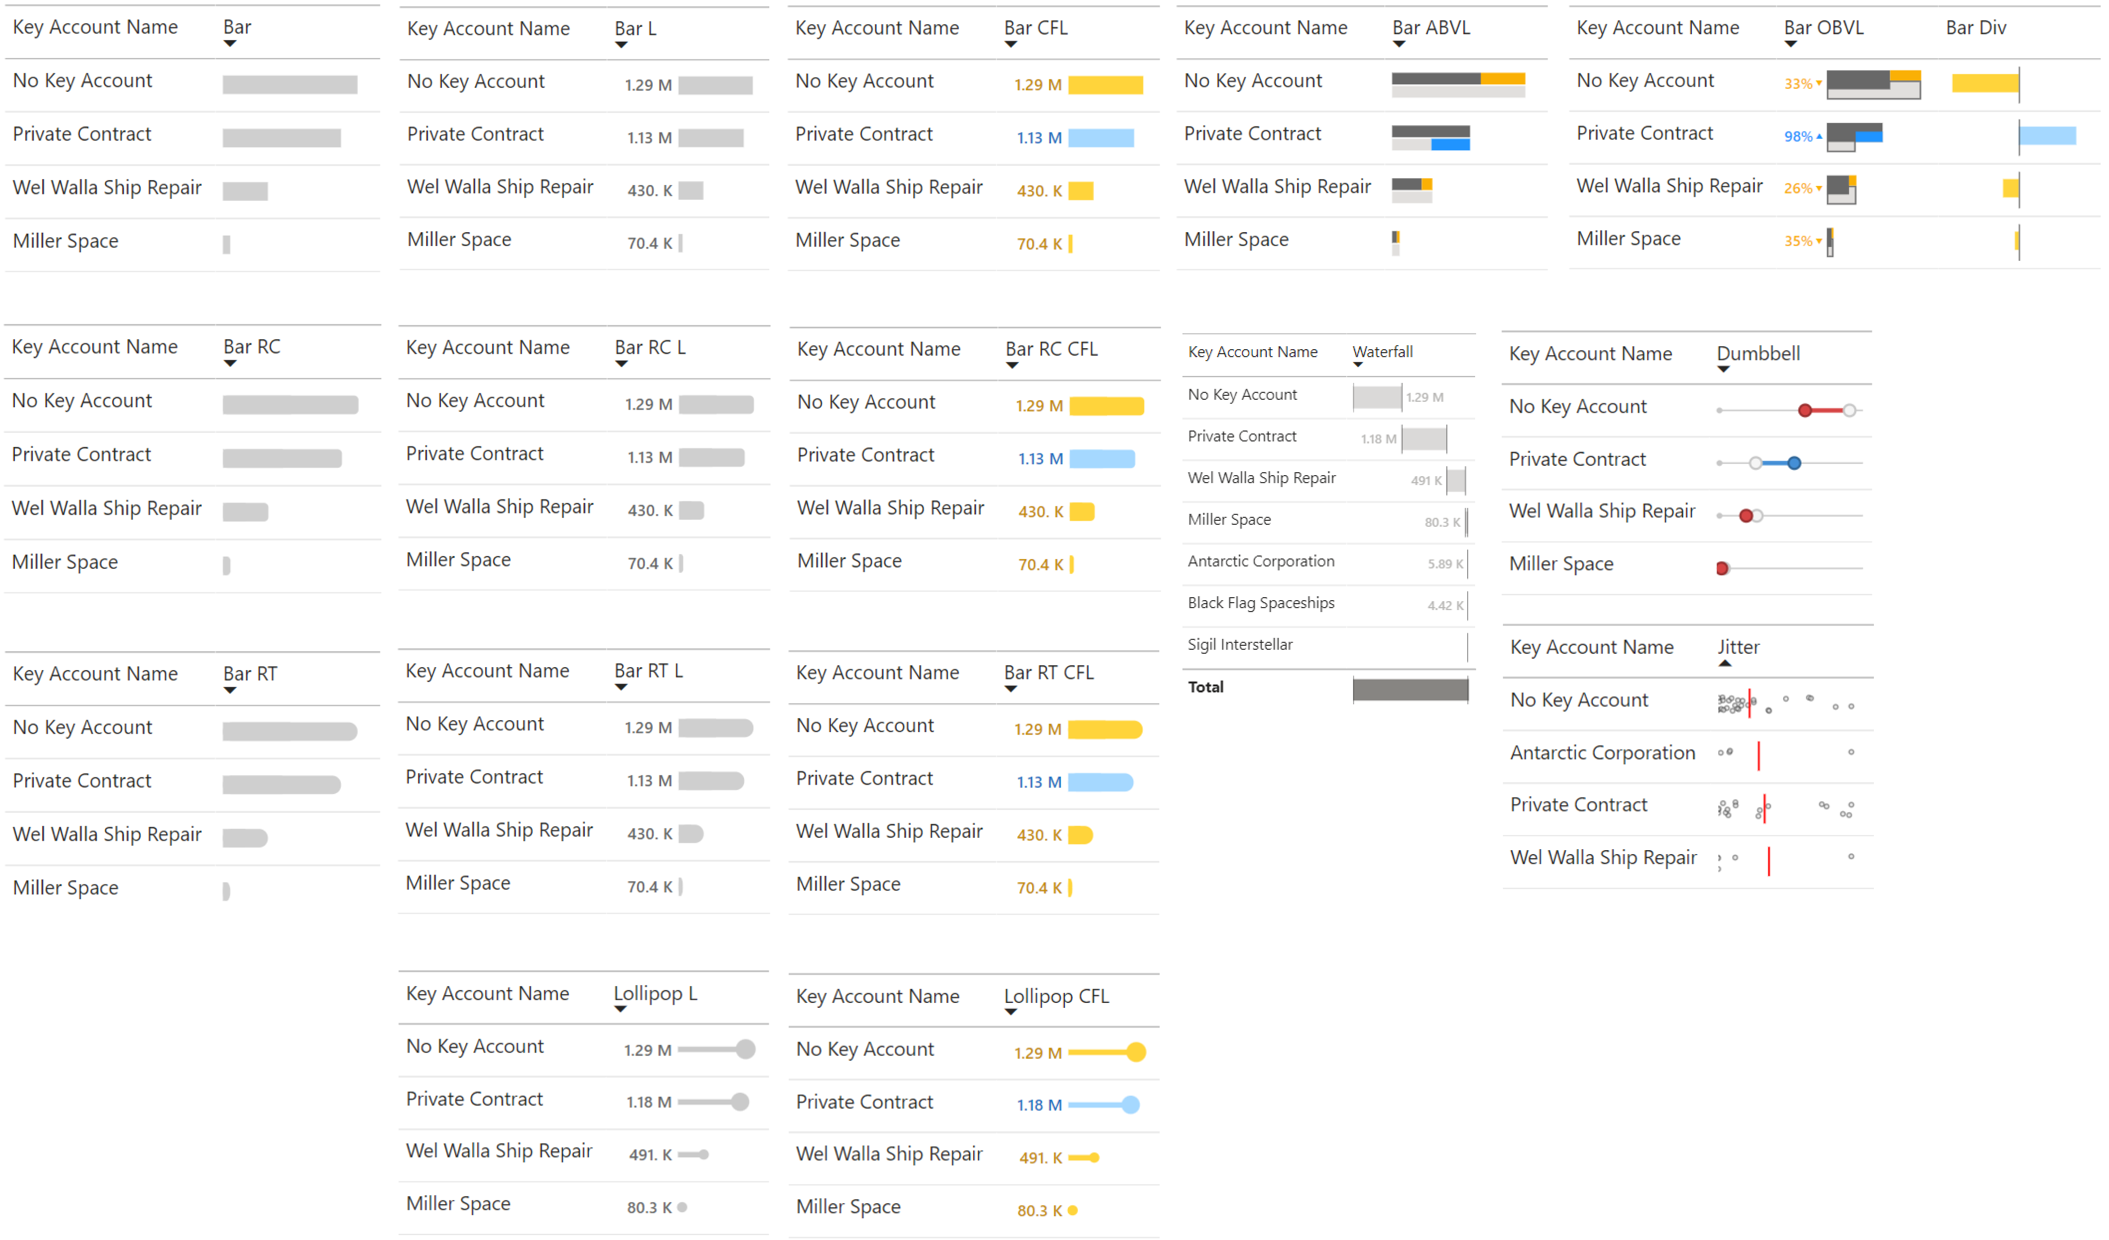
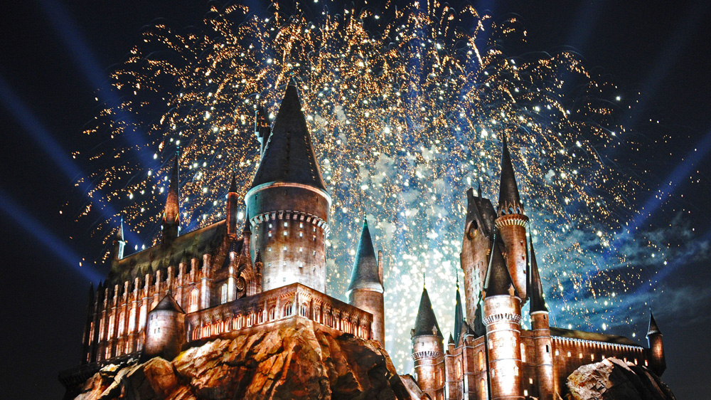
SVG Measures
Credit:
Kurt Buhler
data-goblins.com
https://blog.tabulareditor.com
(Blog post coming soon)
Notes:
DO NOT use the local adventureworks model – because of locale settings, float values are not properly assigned to SVG strings… Use SpaceParts.pbix instead: Macros > Add SVG Chart > Bullet Chart > Label and Qualitative ranges 1. [Gross Sales] 2. [Total Budget] 3. Customer[Key Account Name]

Slide 11
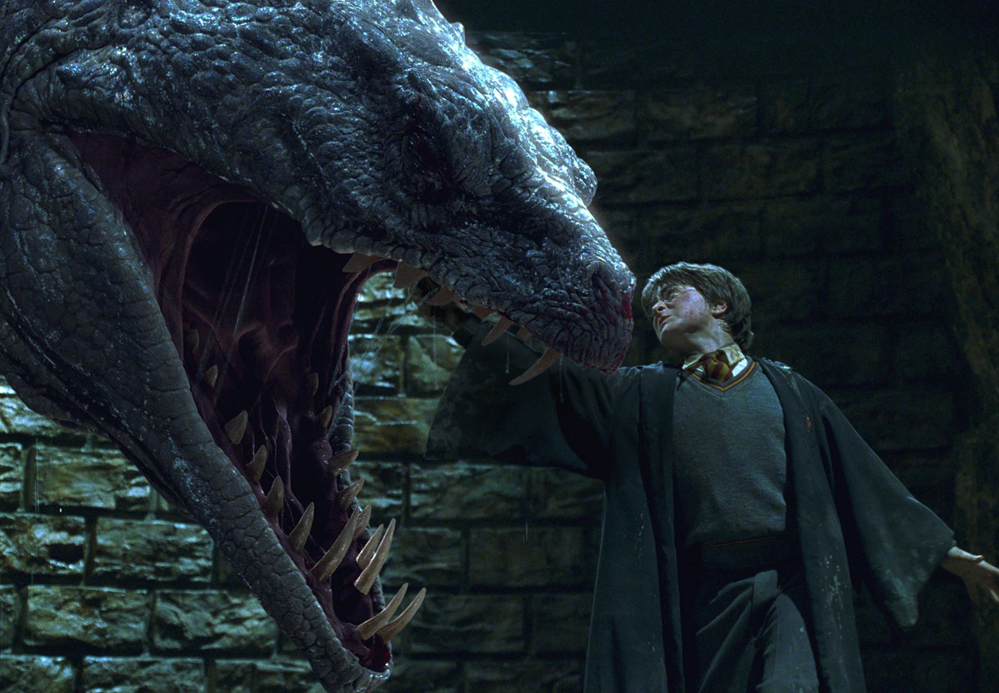
Snek!
Credit:
Kurt Buhler
data-goblins.com

Slide 12
Thank you
All examples can be found here:
https://github.com/otykier/training
Happy scripting ☺

Slide 13
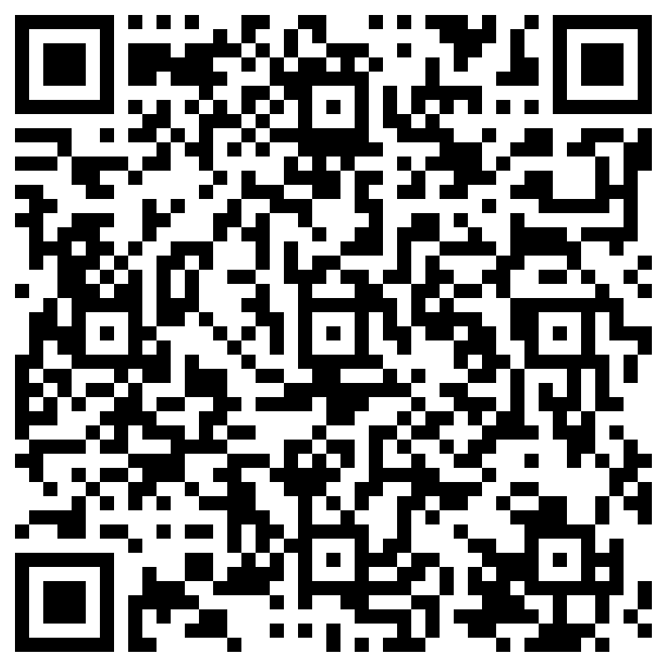
Session evaluation
Do it before end of day raffle
Win a ticket to next years conference!

